Slide 1

2018
NORTH AMERICAN
MCT SUMMIT
February 26 – 28, 2018
Bellevue, WA

Slide 2
Exam Prep 70-533: Implementing Microsoft Azure Infrastructure Solutions
February 26 – 28, 2018
Bellevue, WA

Slide 3

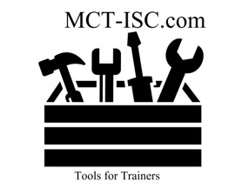

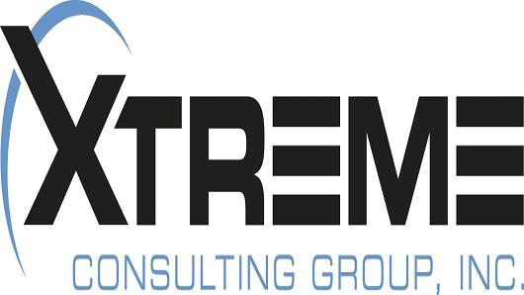



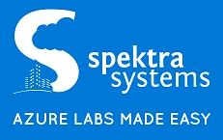
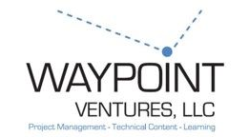


Take a Moment to Thank Our Sponsors…
GOLD
SILVER
PLATINUM
BRONZE
SUMMIT SUPPORTERS

Slide 5
Overview
    In this presentation:
    Helpful Study Resources
    Learn Exam Objectives
    Key Focus Points

Slide 6
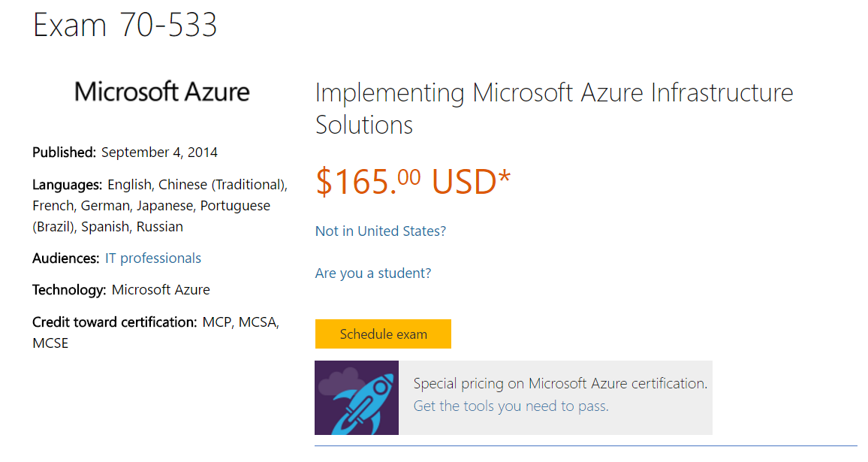
The 70-533 Exam Page
http://aka.ms/70-533

Slide 7
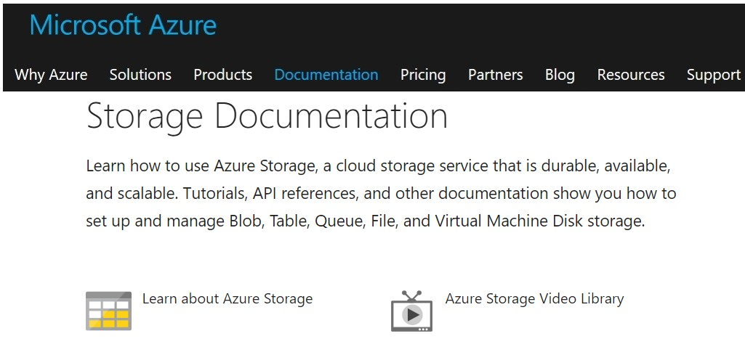
Microsoft Azure Documentation
https://docs.microsoft.com/en-us/azure/storage

Slide 8
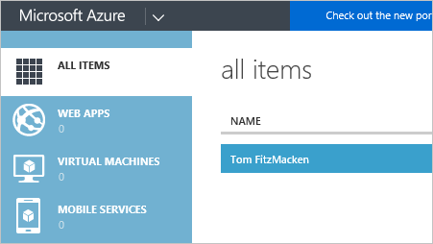
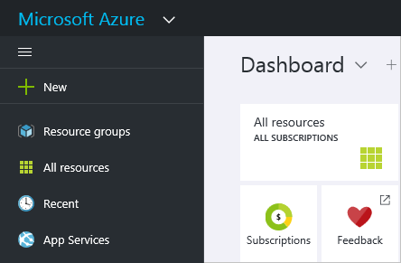
ASM vs ARM
https://tinyurl.com/ASM-ARM
Azure Services Manager (Classic)
Retired on 1/8/18)
Azure Resources Manager (Current)

Slide 9
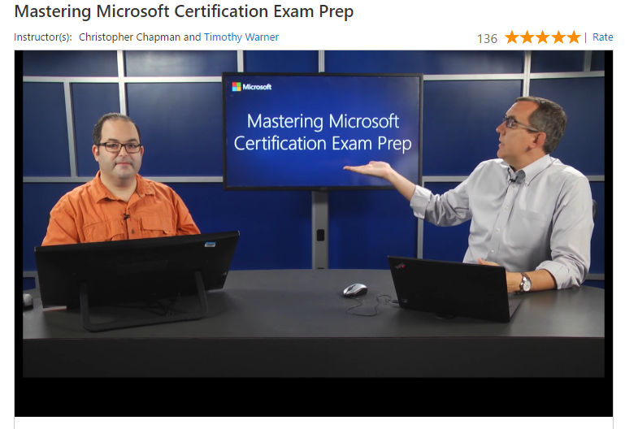
Microsoft Virtual Academy
https://mva.microsoft.com

Slide 10
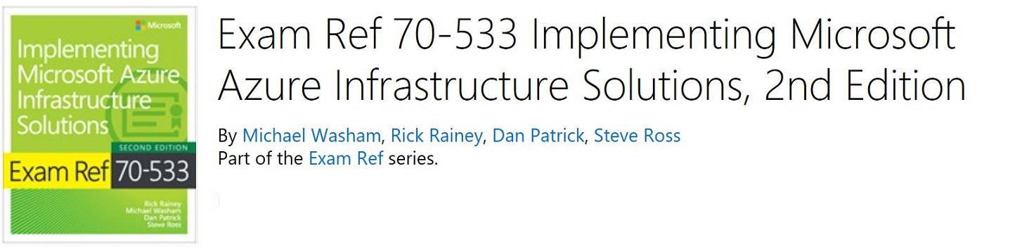
Exam Ref Books
Microsoft Press: Get a 40-percent discount on printed books and a 50-percent discount on e-books. Use code MCTBOOK or MCTeBOOK at checkout.

Slide 11
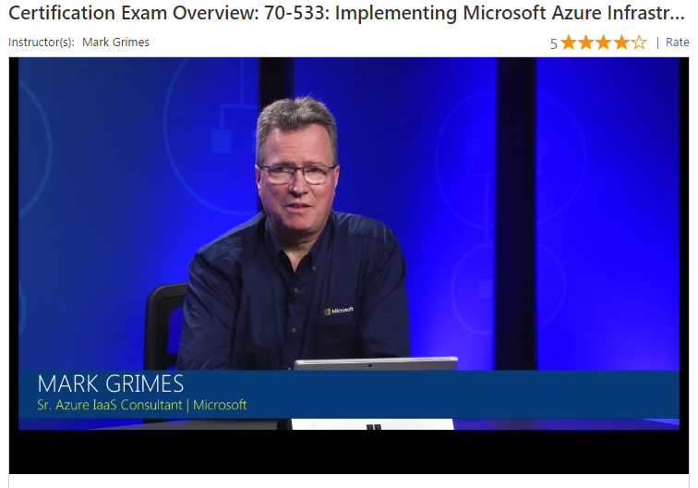
Microsoft Virtual Academy
https://mva.microsoft.com

Slide 12
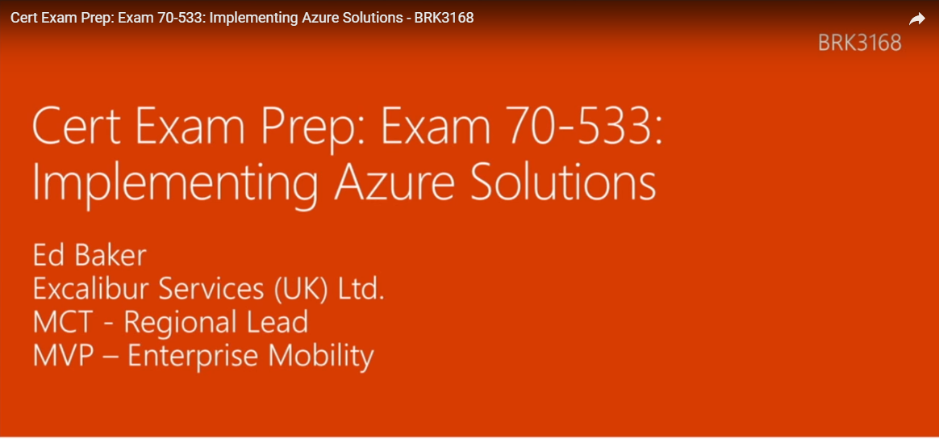
Microsoft Ignite Exam Prep
http://bit.ly/CH9-533

Slide 13
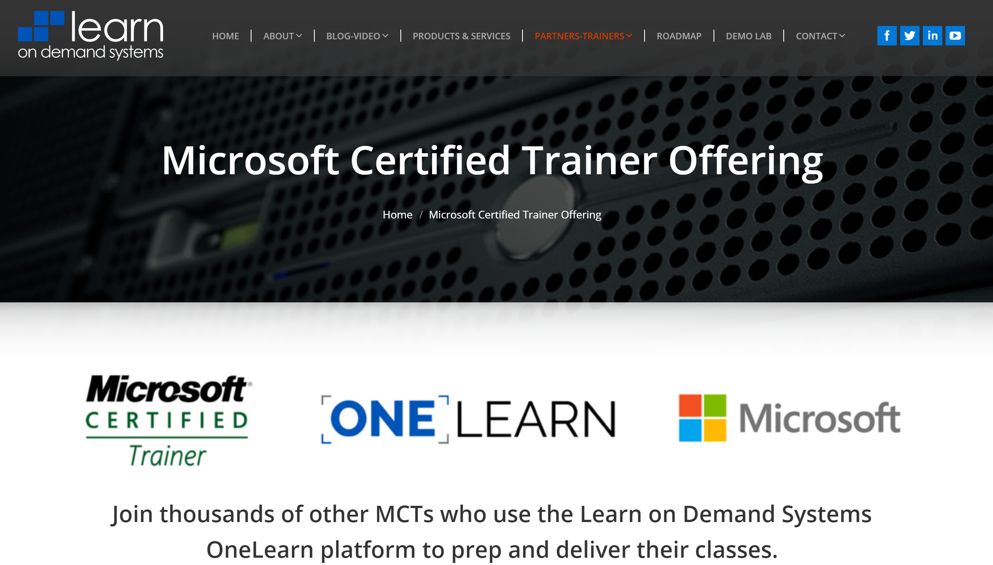
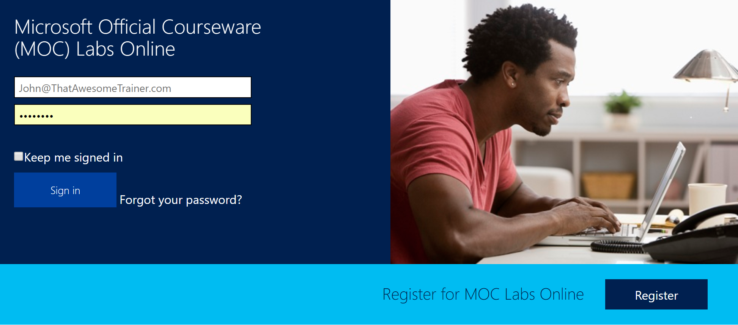
MCT Practice Labs
http://bit.ly/LOD-MCT
http://bit.ly/MLO-MCT

Slide 14
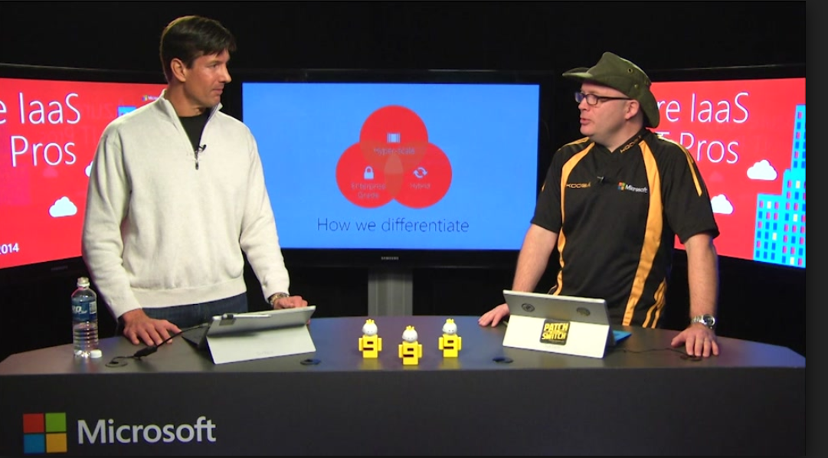
Azure IaaS for IT Pros Webinar Series
http://bit.ly/Azure-IaaS-Pro

Slide 15
Major Areas of the Exam
Implement
Virtual Networks
(15–20%)
Implement
Azure App Services
(15–20%)
Deploy ARM
Templates
(10–15%)
Create and Manage
Compute Resources
(20-25%)
Implement an
Azure Active Directory
(25-30%)
Design and Implement
a Storage Strategy
(10-15%)

Slide 16
October Refresh of the Objective Domains
Manage Containers with Azure Container Services (ACS)
Manage Azure Operations
Manage Azure Identities
Azure Active Directory (Azure AD)

Slide 17
Implement Azure App Service

Slide 18
Implement Azure App Service
Be sure to understand how to…
Deploy and Configure Web Apps
Configure Diagnostics
Monitor Analytics
Configure Web Apps for scale and resilience
https://docs.microsoft.com/en-us/azure/api-management/

Slide 19
Deploy
Web
Apps
Define Deployment Slots
  Can Clone or not
  A Hostname and Live App per Slot
  Know things that are swapped and not!
  Know Swap with preview (multi-phase swap)
  & Auto Swap
  See Setting Up Staging Environments in Azure App Service
Rollback Deployments
  When issues or errors in swapping
  Can Warm-up, Delete
  See PowerShell and CLI Examples

Slide 20
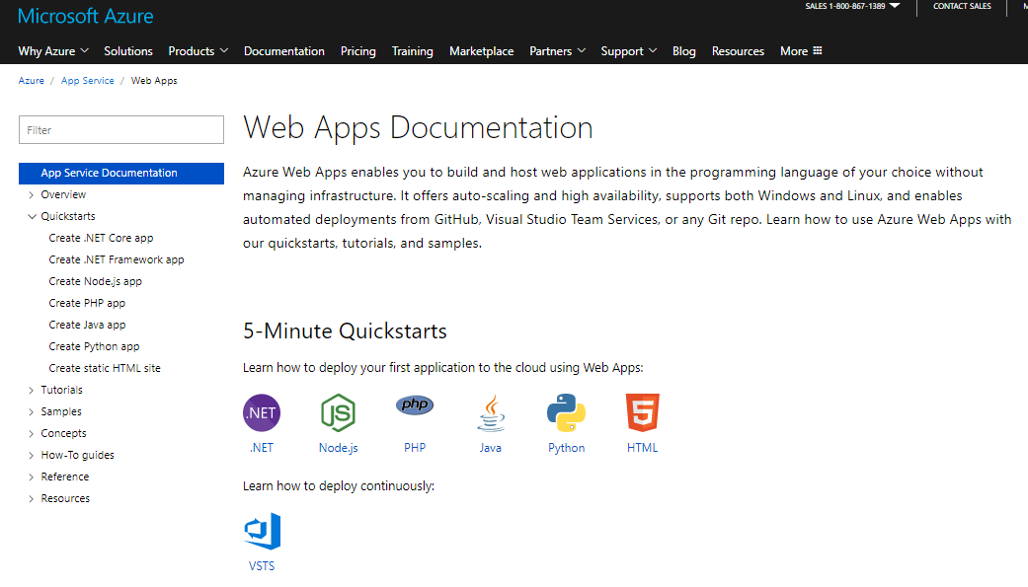
Web Apps Overview
)
http://aka.ms/Azure/AppService

Slide 21
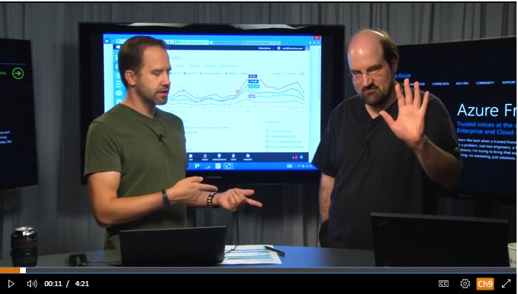
Azure Web Sites Endpoint Monitoring
Azure Friday Video)
https://azure.microsoft.com/en-us/resources/videos/azure-friday/

Slide 22
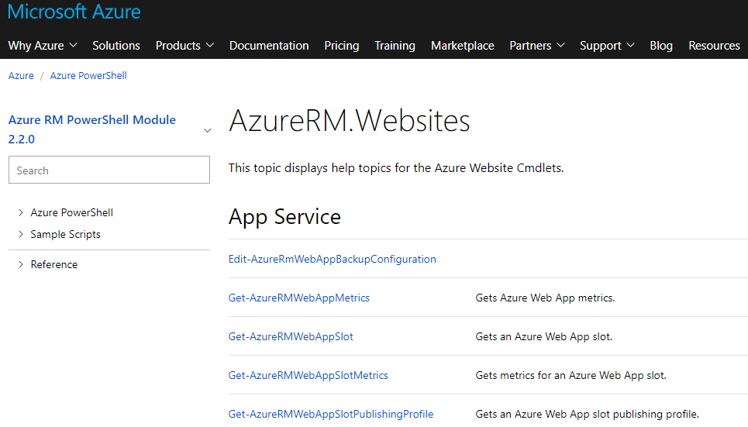
AzureRM Powershell Cmdlets
http://bit.ly/AzureRM-PS

Slide 23
Create and Manage Compute Resources

Slide 24
Create and Manage Compute Resources
Be sure to understand how to…
Deploy VM Workloads
Automate and Manage using PowerShell DSC
Configure ARM VM Networking
Scale VM and Implement Storage
Monitor Virtual Machines and Availability
https://docs.microsoft.com/en-us/azure/virtual-machines

Slide 25
Windows Server
  Sysprep VHD – OOBE and “Generalized”
  Create Storage Account and Container
  Upload VHD file
  Add Image Add-AzureVMImage
  Create VM with ARM Template or by command line
Linux
  Must be Linux on Azure Endorsed
  Create a Resource Group
  Create a Storage Account
  List Access Keys
  Create containers with Access Keys above
  Upload VHD to container
  Can now create VM with ARM Template or by CLI
  Read more
Create and
Upload
Custom
VHDs

Slide 26
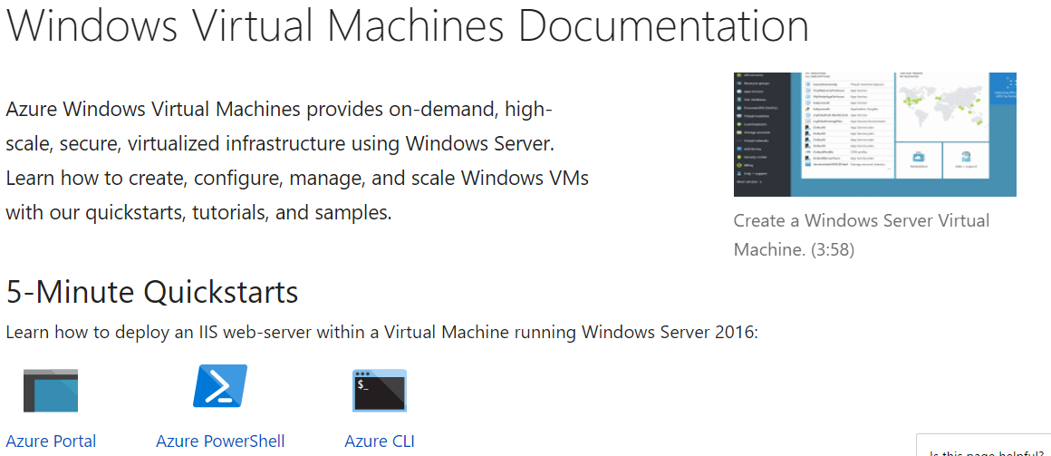
Be sure to practice all three methods!
https://docs.microsoft.com/en-us/azure/virtual-machines
Notes:
HDInsight uses the Hortonworks Data Platform (HDP) Hadoop distribution
With that there are various types of clusters that can be used- and that really depends on data and purpose:
Spark - in-memory analytics : SQL& ML
Spark processing engine is built for speed, ease of use, and sophisticated analytics. Spark's in-memory computation capabilities make it a good choice for
Hbase – noSQL for unstructured/semistructured data
Storm – streaming but better for real time analysis
Key to know what integrates with:
PowerBI, Excel, SSAS, SSRS.

Slide 27
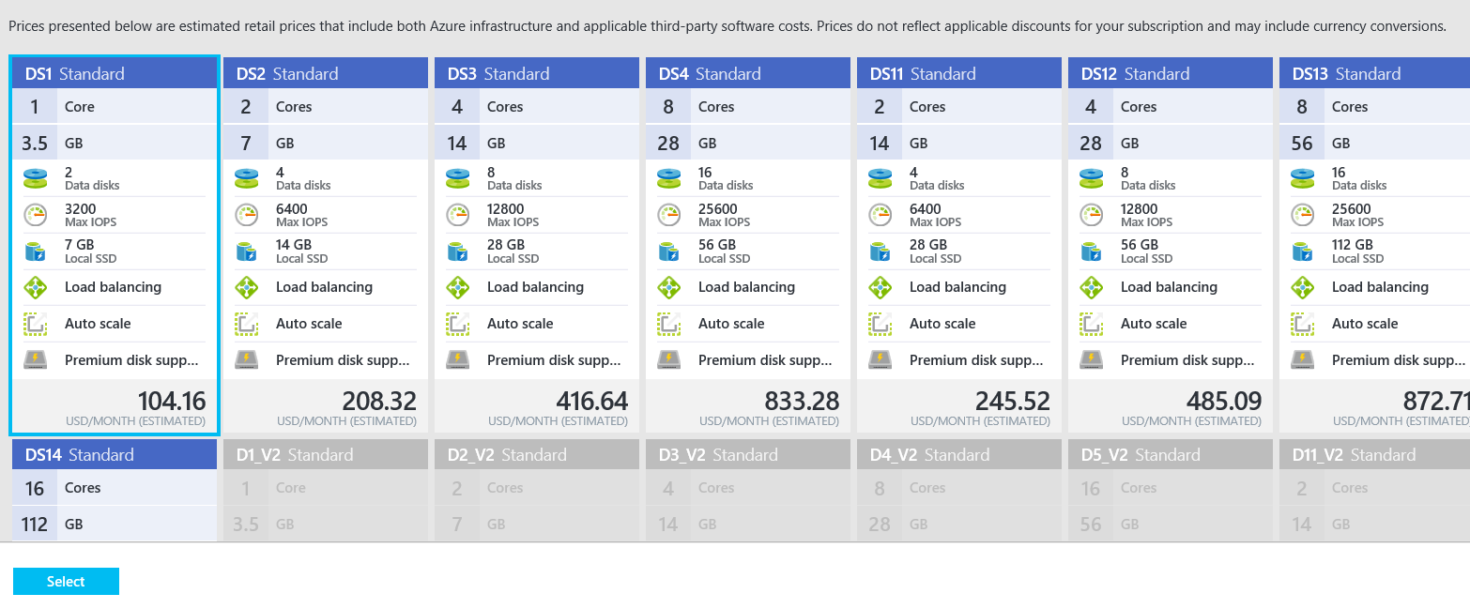
Virtual Machine Sizes
https://docs.microsoft.com/en-us/azure/virtual-machines/windows/sizes

Slide 28
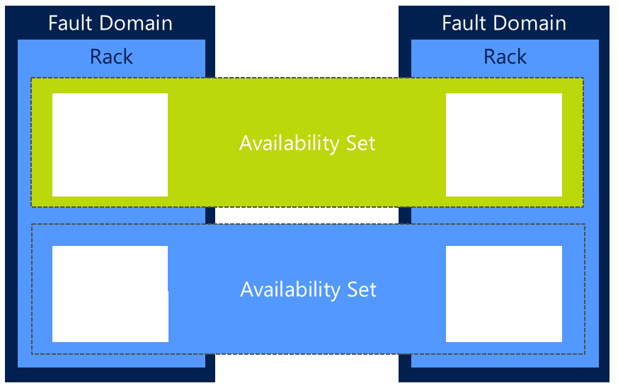
Fault and Update Domains
Fault Domains
  Physical groups of resources in the same rack. (Server, Power, Network Switch)
  Availability Set spread across minimum of two fault domains
Update Domains
  Logical groups of resources to be updated together
  Default of 5 (up to 20)
  Only 1 rebooted at a time
http://bit.ly/fault-update

Slide 29
Design and Implement a Storage Strategy

Slide 30
Understand the different Storage options
https://docs.microsoft.com/en-us/azure/storage

Slide 31
Configure Geo-Replication
  LRS – 3 local copies
  ZRS – 3 copies within a region
  GRS – 3 copies in 2 data centers
  RA-GRS Read-Access geo-redundant
  allows read access at secondary when primary region becomes unavailable.
Local Redundant Storage
Zone Redundant Storage
Geo Redundant Storage
Read Access Geo Redundant Storage
NOTE: Once selected, can’t change!

Slide 32
Implement an
Azure Active Directory

Slide 33
Azure Active Directory
Azure
Active Directory
Active Directory
B2B
Active Directory B2C
Integrate an App with Azure Active Directory
Configure Application Access

Slide 34
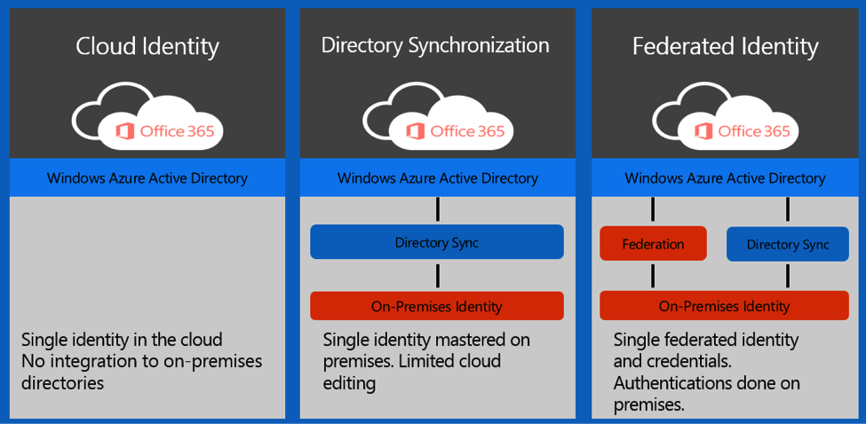
Azure Active Directory

Slide 35



Azure Business to Consumer (B2C)
Sign up, Sign in, Password reset & other policies
Social & Local Accounts
Seamless User Experience
Multi-Factor Authentication
••••••••••
••••••••••
Protocol support
(OIDC, OAuth2)
Azure AD
Graph API
http://aka.ms/Azure/B2C

Slide 36
Comparison of Azure AD capabilities
Consider this Product | Azure AD Multi-tenant SaaS app | Azure AD B2B | Azure AD B2C
If I need to provide | A service to businesses | Partner access to my apps | A service to consumers
And I am similar to | Pharm Distribution | Imaging company | Sports Franchise
Deploying an App for… | Practice Management | Supplier extranet | Soccer Fans
Targeting… | Doctor’s offices | Approved Business Partners | Anyone with email
Accessible when | Customer admin consents | My admin invites | The consumer signs up

Slide 37
Implement
Virtual Networks

Slide 38
Implement Virtual Networks
Be sure to understand…
Configure Virtual Networks
Network Security Groups
ExpressRoute
User Defined Routes (UDR)
https://docs.microsoft.com/en-us/azure/virtual-network

Slide 39
Configure Static IPs
  Verify IP Address is available
  Test-AzureRMStaticVNetIP –VNetName TestVNet –IPAddress 192.168.4.7
  Specify when creating new VM or for existing
Configure Internal Load Balancing
  Create ILB Instance
  Add endpoint to the ILB Instance
  Configure Servers to send traffic ILB Endpoint
  Existing virtual networks that have been configured for an affinity group cannot use ILB
Configure virtual Networks
http://bit.ly/AzureV-Net

Slide 40
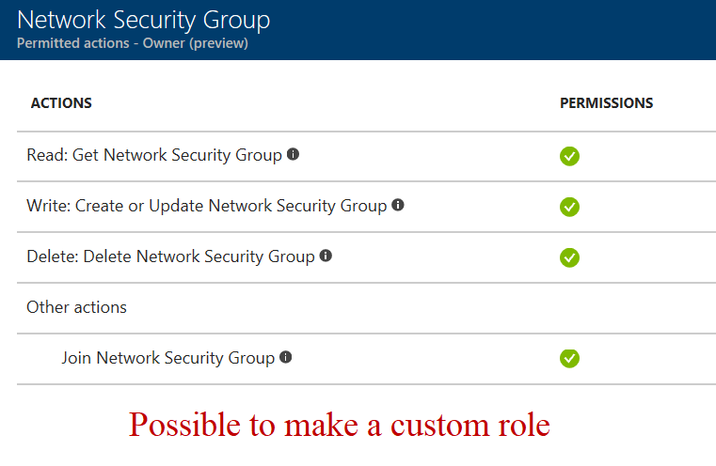
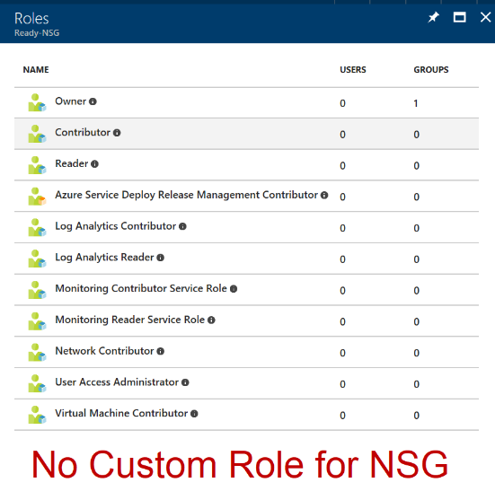
Network Security Group
Default Rules and Tags
  Virtual Network
  Internet
  Load Balancer
  Security Rules applied
  Read Associating NSGs
http://aka.ms/Azure/NSG

Slide 41
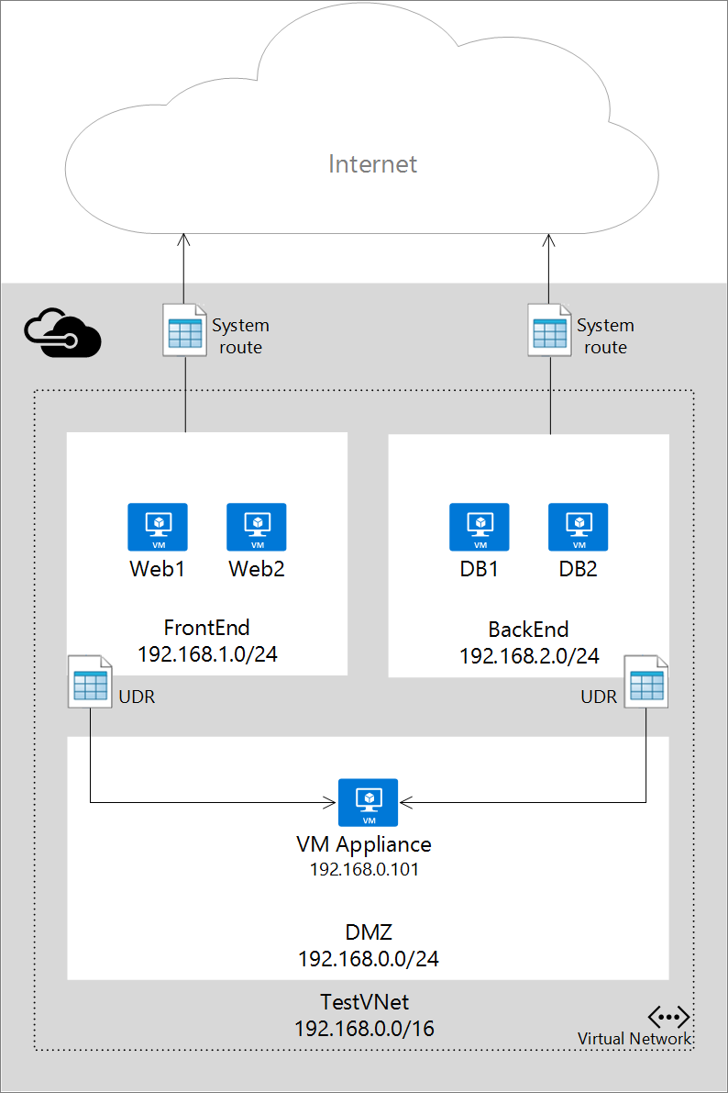
User Defined Routes
System Routes
  Within VNet and VM to Internet.
When to use UDR
  Force tunnel to internet or on-premises
  Use Network Virtual Appliance (NVA)
  Direct subnet traffic up the layers
  Route preference in order
  1. UDR 2. BGP (w/ER) 3. System Route
  See also Create UDR using a Template
http://aka.ms/Azure/UDR

Slide 42
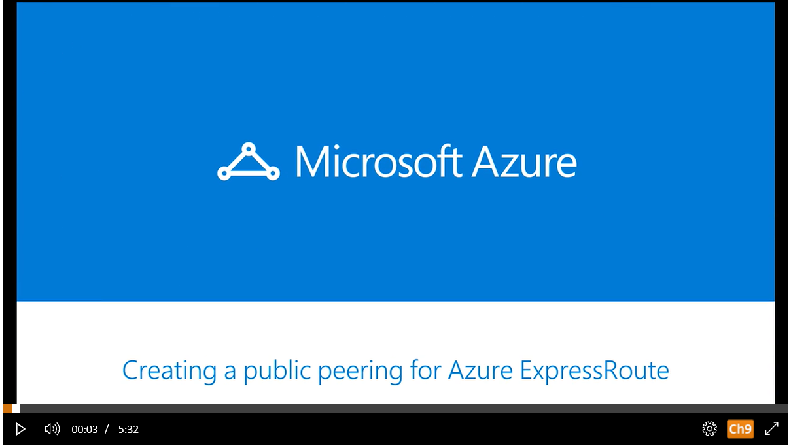
Express Route
http://bit.ly/AzureExpressRoute

Slide 43
Deploy ARM
Templates

Slide 44
ARM Templates
Know the differences and when to use…
Implement ARM Templates
Control Access with Azure AD
Design Role-based Access Control (RBAC)
Deploy Templates with PowerShell, CLI, and REST API
https://docs.microsoft.com/en-us/azure/templates/

Slide 45
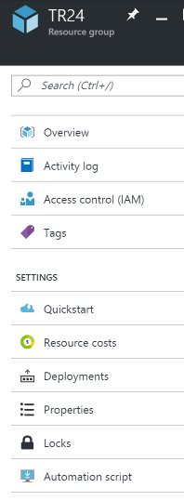
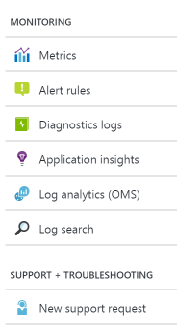
Design Resource Groups
Design Principles
  Organize Azure resources
  Logical Grouping
  Should share same lifecycle
  Can use to scope RBAC
  Cannot Nest them
  Tag and Lock them
Azure Resources within
  Can only live in 1 RG
  Can add/remove any time
  Can be from different regions
  READ THIS aka.ms/Azure/ARM
  and aka.ms/Azure/RBAC

Slide 46
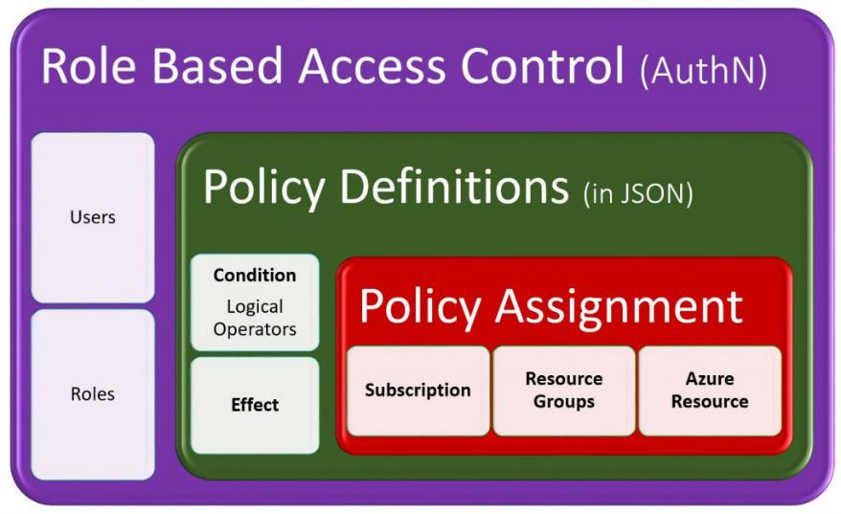
Set ARM policies
http://aka.ms/Azure/Policies

Slide 47
Study Focus Tips
Azure App Services
Manage Compute Resources
Virtual Machine Networking
Storage and Redundancy
Azure Active Directory
Azure ARM Templates
Azure Container Services
Manage Azure Identities
Integrate Azure AD
Notes:
There are other targets for hyperlinks that are not covered in the course (such as Frame).

Slide 48

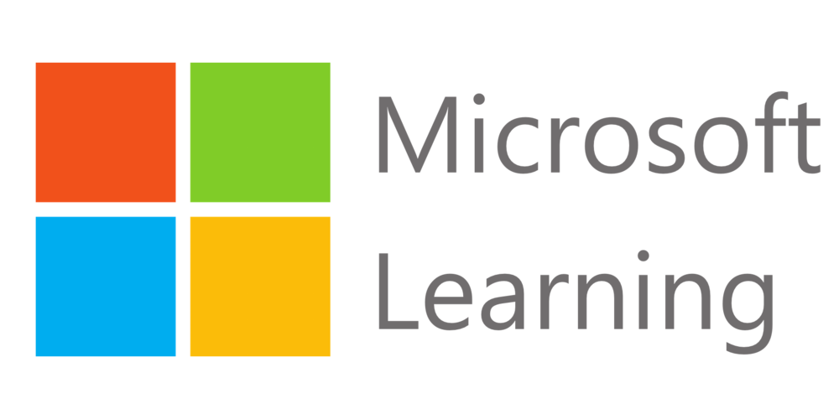



Take a Moment to Thank Our Sponsors…
GOLD SPONSORS:
SILVER SPONSORS
PLATINUM SPONSOR:
BRONZE SPONSORS
SUMMIT SUPPORTERS:

Slide 49
Good Luck
70-533: Microsoft Azure Infrastructure Solutions

